Slide 1
Digital Fundamentals
CHAPTER 4 Boolean Algebra and Logic Simplification

Slide 2
Chapter Outline
4–1 Boolean Operations and Expressions
4–2 Laws and Rules of Boolean Algebra
4–3 DeMorgan’s Theorems
4–4 Boolean Analysis of Logic Circuits
4–5 Logic Simplification Using Boolean Algebra
4–6 Standard Forms of Boolean Expressions
4–7 Boolean Expressions and Truth Tables
4–8 The Karnaugh Map
4–9 Karnaugh Map SOP Minimization
4–10 Karnaugh Map POS Minimization
4–11 The Quine-McCluskey Method
4–12 Boolean Expressions with VHDL Applied Logic

Slide 3
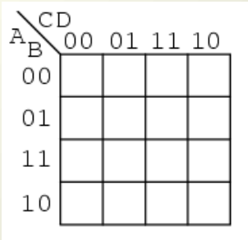
ABCD | m
0000 | m0
0001 | m1
0010 | m2
0011 | m3
0100 | m4
0101 | m5
0110 | m6
0111 | m7
1000 | m8
1001 | m9
1010 | m10
1011 | m11
1100 | m12
1101 | m13
1110 | m14
1111 | m15
Larger 4-variable Karnaugh Maps
m₀
m₁
m₃
m₂
m₄
m₅
m₇
m₆
m₁₂
m₁₃
m₁₅
m₁₄
m₈
m₉
m₁₁
m₁₀

Slide 4
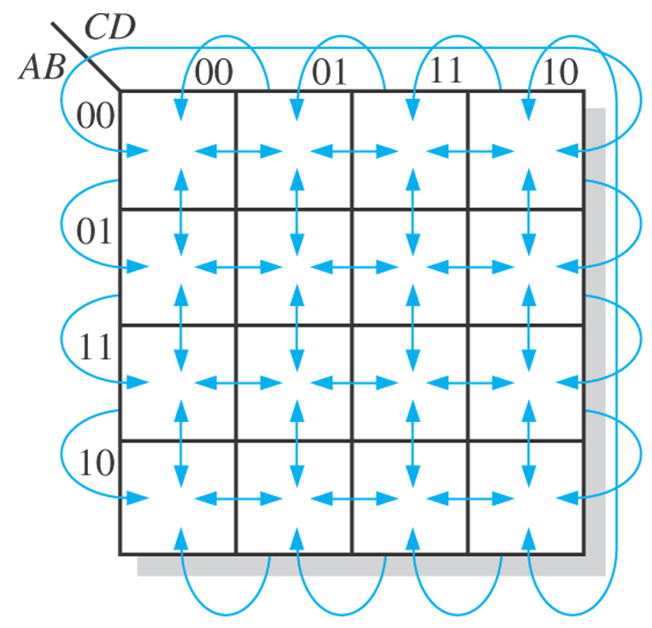
Figure 4–23 Adjacent cells on a Karnaugh map are those that differ by only one variable. Arrows point between adjacent cells.
Notes:
4

Slide 5
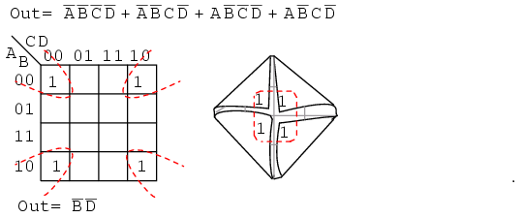
EXAMPLE: Larger 4-variable Karnaugh Maps
A B C D +A BCD +AB C D +ABCD
∑ m(0,2,3,10)
0000=m₀
0010=m₂
1000=m₈
1010=m₁₀

Slide 6
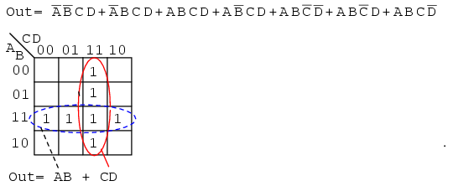
EXAMPLE: Larger 4-variable Karnaugh Maps
0011=m₃
0111=m₇
1111=m_{15`}
1011=m₁₁
1100=m_{12`}
1101=m_{13`}
1110=m_{14`}

Slide 7
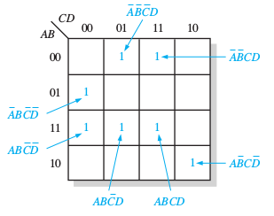
EXAMPLE: Larger 4-variable Karnaugh Maps
Map the following standard SOP expression on a Karnaugh map:
0011
0100
1101
1111
1100
0001
1010

Slide 8
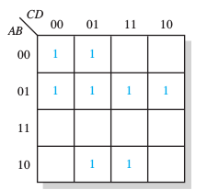
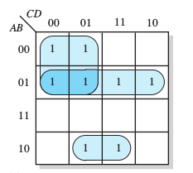
EXAMPLE: Larger 4-variable Karnaugh Maps
Determining the Minimum SOP Expression from the Map

Slide 9
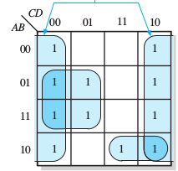
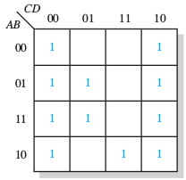
EXAMPLE: Larger 4-variable Karnaugh Maps
Determining the Minimum SOP Expression from the Map
D
+ ABC
+ ABC
+ BC

Slide 10
Mapping a Nonstandard SOP Expression
Figure 4–28
Numerical Expansion of a Nonstandard Product Term
AB
First, write the binary value of the two variables and attach a 0 for the missing variable C: 100.
Next, write the binary value of the two variables and attach a 1 for the missing variable C: 101
B
010
011
110
111
Notes:
10

Slide 11
EXAMPLE: Mapping a Nonstandard SOP Expression
Figure 4–28
Map the following SOP expression on a Karnaugh map: A + AB + ABC.
A + AB + ABC.
000
001
100
101
110
010
011
B
A
00
01
11
10
0
1
1
1
1
1
1
1
0
1
Notes:
11

Slide 12
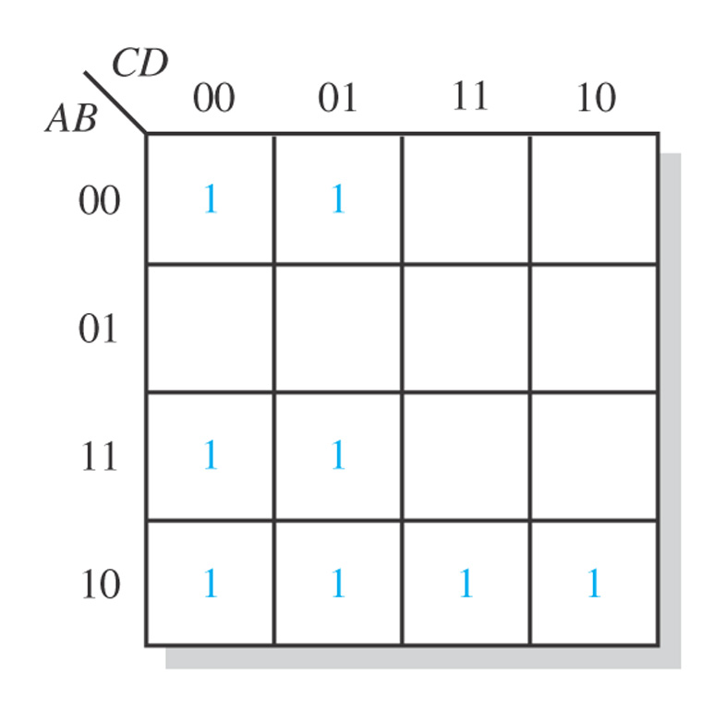
Figure 4–28
Map the following SOP expression on a Karnaugh map:
0000
0001
1000
1001
1000
1001
1010
1011
1100
1101
1010
0001
1011
Task: Map the expression A + CD + ACD + ABCD on a Karnaugh map.
Notes:
12

Slide 13
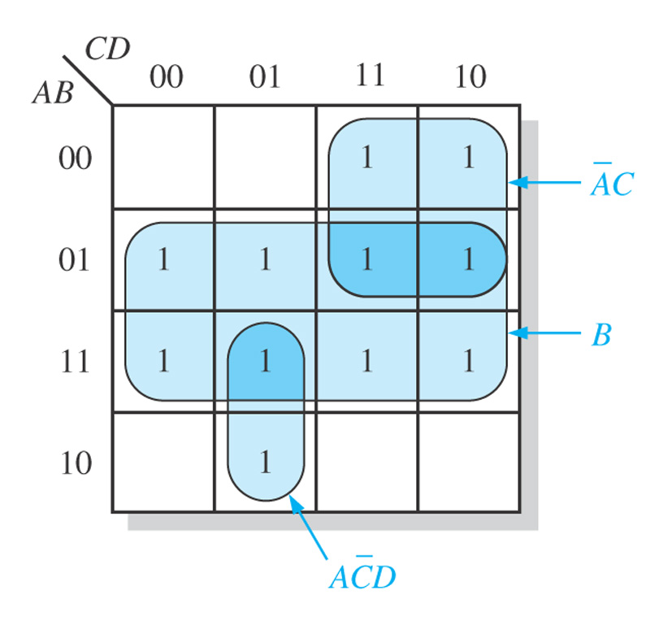
1
1
1
1
1
Notes:
13

Slide 14
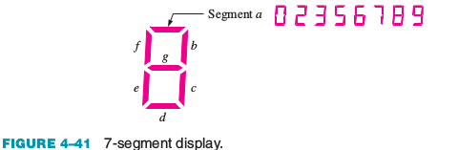
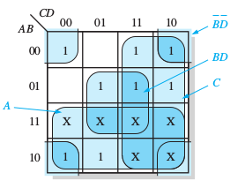
Figure 4–36 Example of the use of “don’t care” conditions to simplify an expression.
In a 7-segment display, each of the seven segments is activated for various digits. For example, segment a is activated for the digits 0, 2, 3, 5, 6, 7, 8, and 9, as illustrated in Figure 4–41. Since each digit can be represented by a BCD code, derive an SOP expression for segment a using the variables ABCD and then minimize the expression using a Karnaugh map
Notes:
14

Slide 15
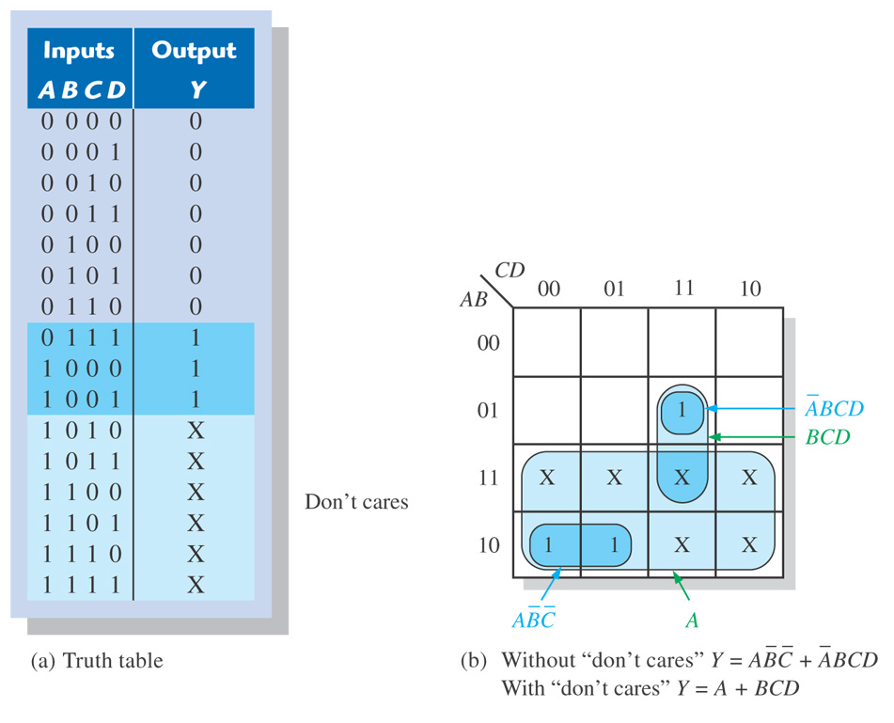
Figure 4–36 Example of the use of “don’t care” conditions to simplify an expression.
∑ m(7,8,9) ∑ d(10, 11,12,13, 14, 15)
Notes:
15

Slide 16
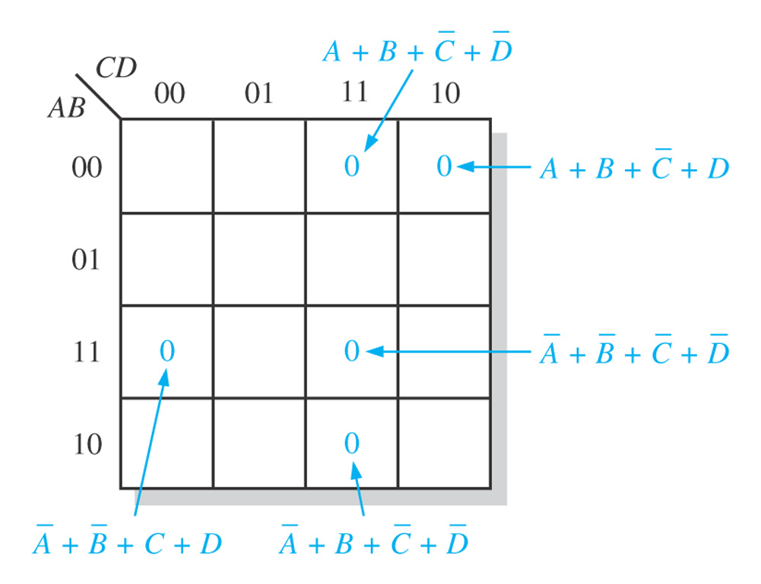
4–10 Karnaugh Map POS Minimization
∏ M (2,3, 11, 12, 15)
Figure 4–38
1100
1011
0010
1111
0011
Notes:
16

Slide 17
4–10 Karnaugh Map POS Minimization
∏ M (2,3, 11, 12, 15)
Figure 4–38
1100
1011
0010
1111
0011
Notes:
17

Slide 18
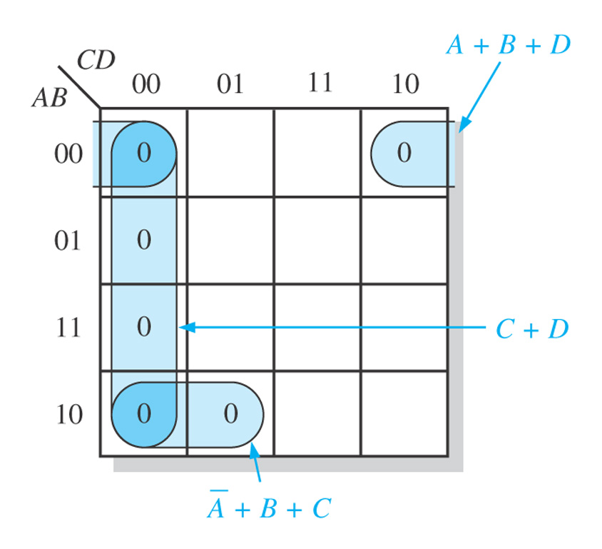
Figure 4–40
Notes:
18

Slide 19
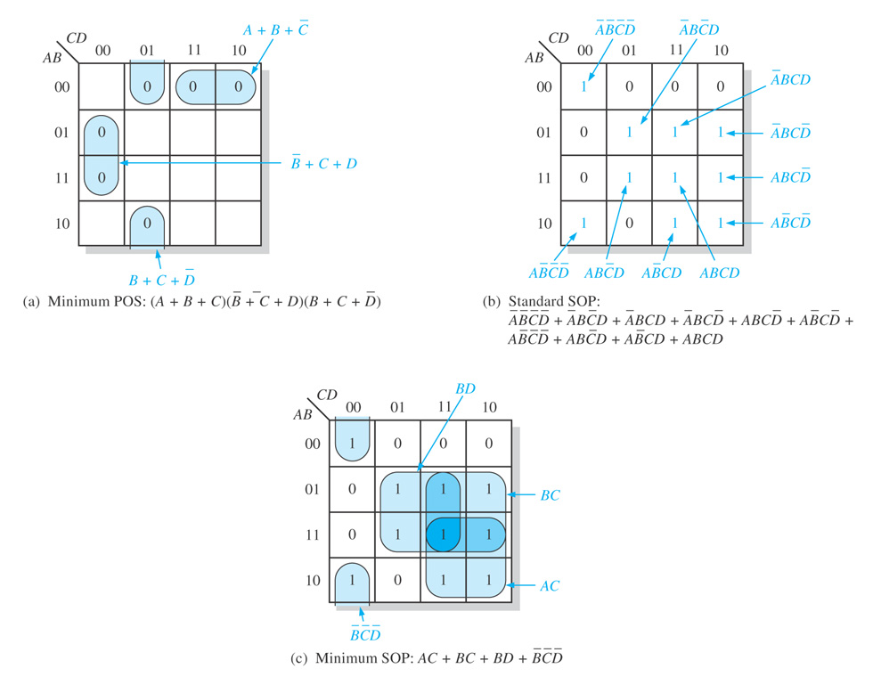
Figure 4–41
Notes:
19

Slide 20
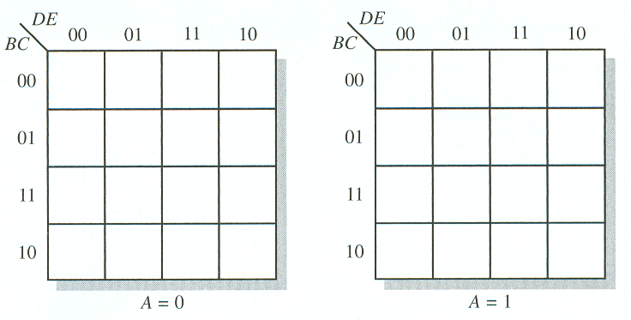
The Karnaugh Map
5-Variable Karnaugh Mapping

Slide 21
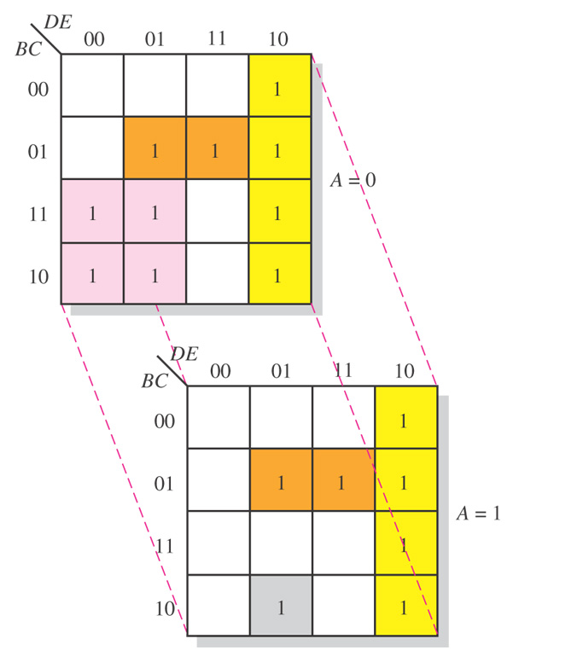
Figure 4–43 Illustration of groupings of 1s in adjacent cells of a 5-variable map.
Notes:
21

Slide 22
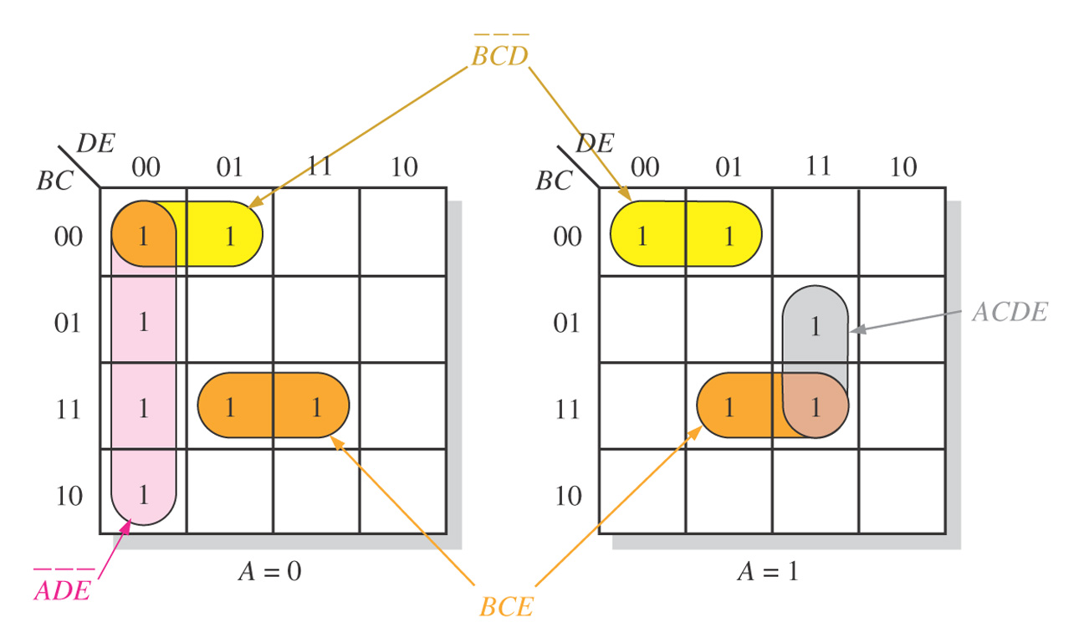
Figure 4–44
Notes:
22

Slide 23
VHDL

Slide 24
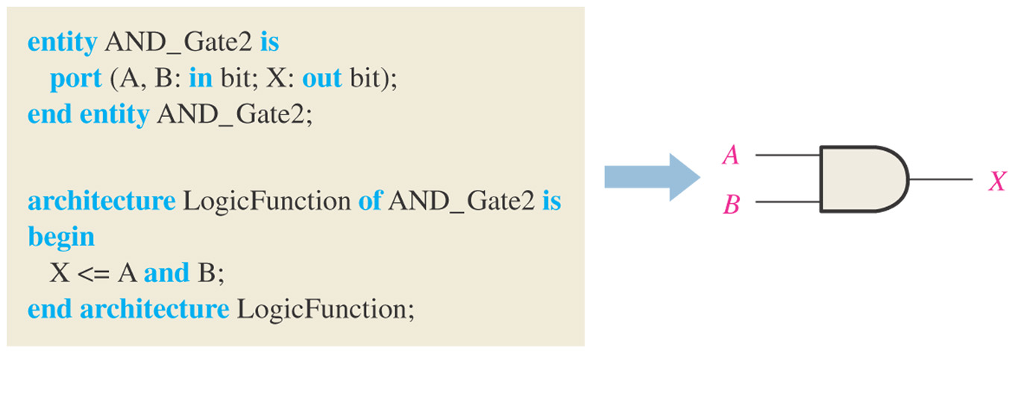
Figure 4–45 A VHDL program for a 2-input AND gate.
Notes:
24

Slide 25
VHDL
VHDL Operators
and
or
not
nand
nor
xor
xnor
VHDL Elements
entity
architecture

Slide 26
VHDL
Entity Structure
Example:
entity AND_Gate1 is
port(A,B:in bit:X:out bit);
end entity AND_Gate1

Slide 27
VHDL
Architecture
Example:
architecture LogicFunction of AND_Gate1 is
begin
X<=A and B;
end architecture LogicFunction

Slide 28
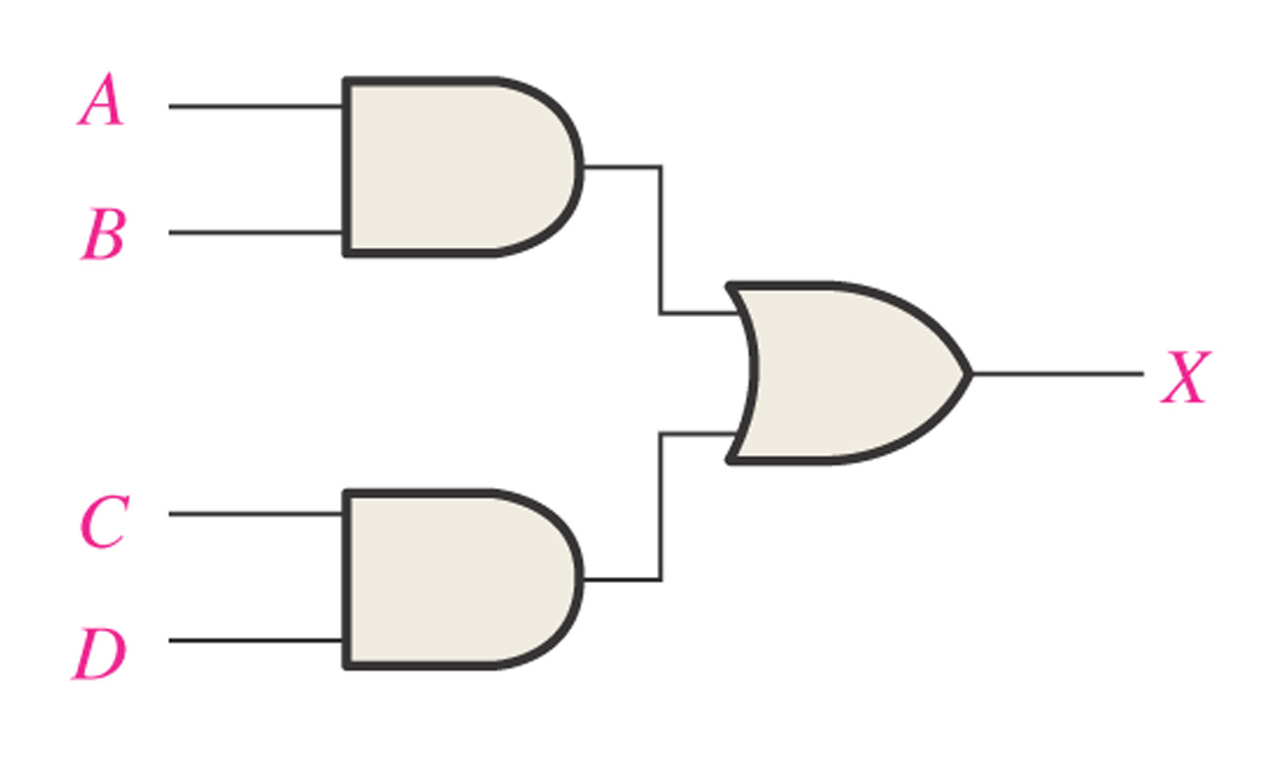
Figure 4–46
Notes:
28

Slide 29
Hardware Description Languages (HDL)
Boolean Expressions in VHDL
AND X <= A and B;
OR X <= A or B;
NOT X <= A not B;
NAND X <= A nand B;
NOR X <= A nor B;
XOR X <= A xor B;
XNOR X <= A xnor B;

Slide 30
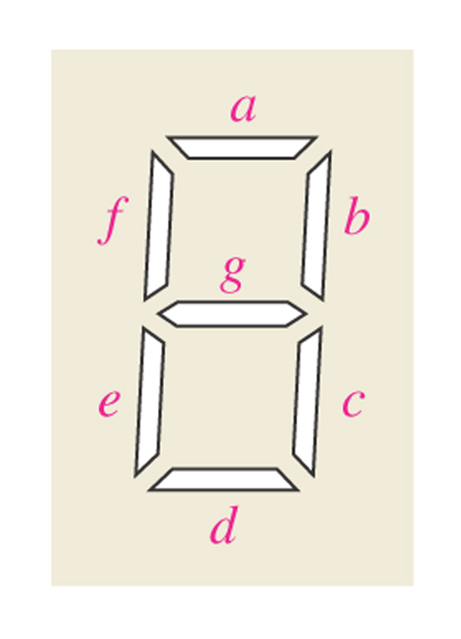
Figure 4–47 Seven-segment display format showing arrangement of segments.
Notes:
30

Slide 31
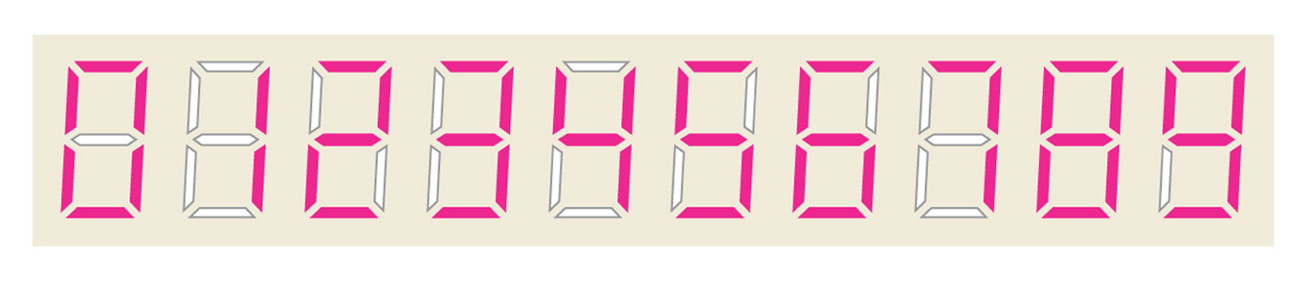
Figure 4–48 Display of decimal digits with a 7-segment device.
Notes:
31

Slide 32
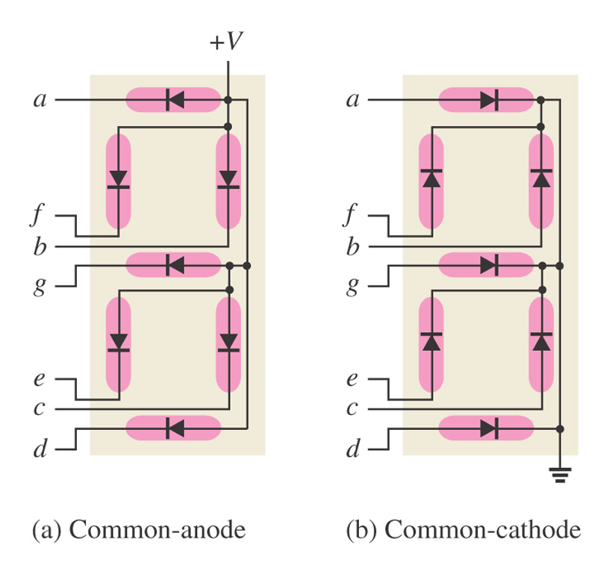
Figure 4–49 Arrangements of 7-segment LED displays.
Notes:
32

Slide 33
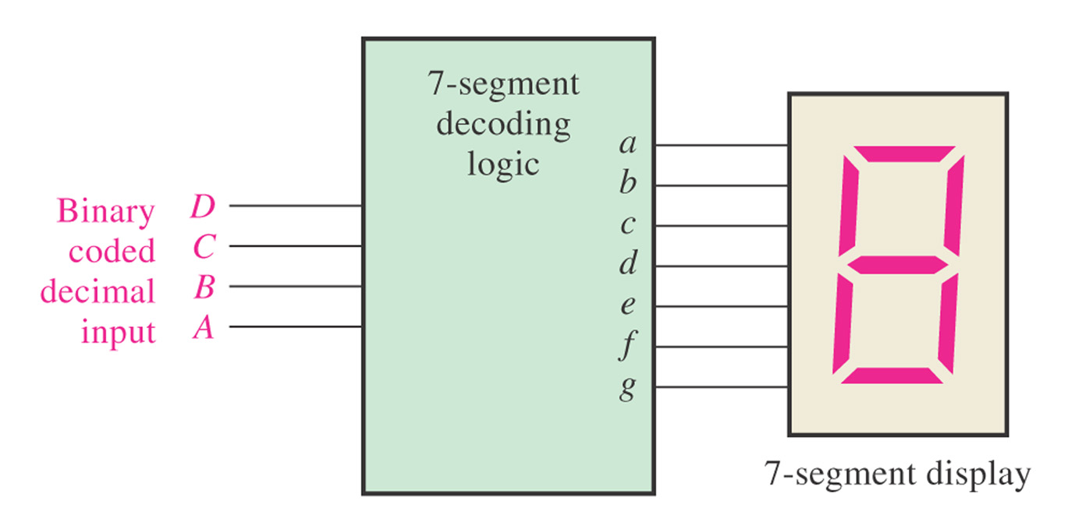
Figure 4–50 Block diagram of 7-segment logic and display.
Notes:
33

Slide 34
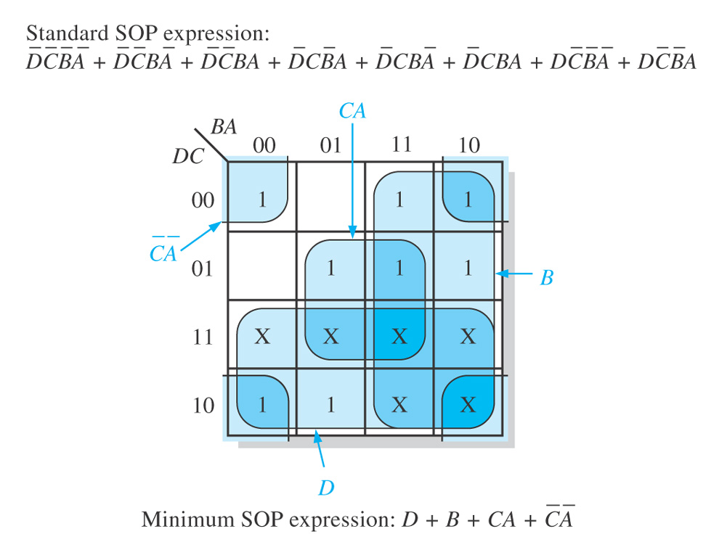
Figure 4–51 Karnaugh map minimization of the segment-a logic expression.
Notes:
34

Slide 35
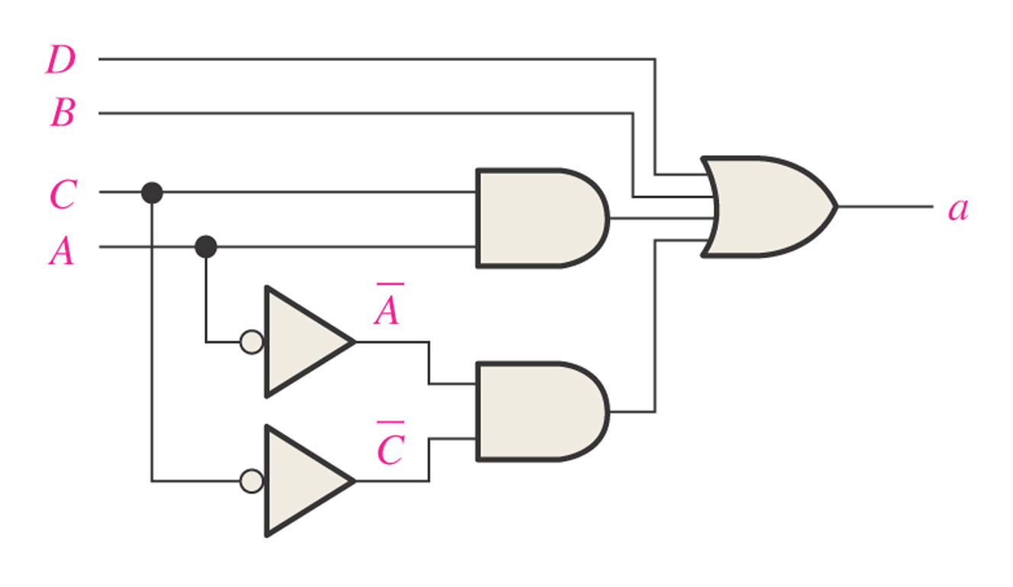
Figure 4–52 The minimum logic implementation for segment a of the 7-segment display.
Notes:
35

Slide 36
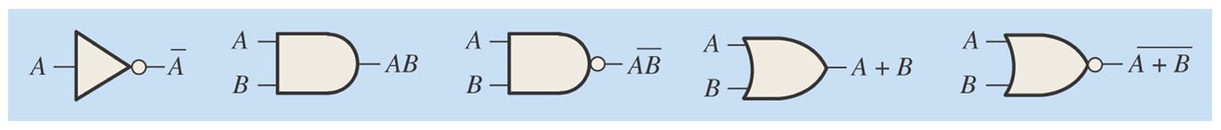
Summary

Slide 37
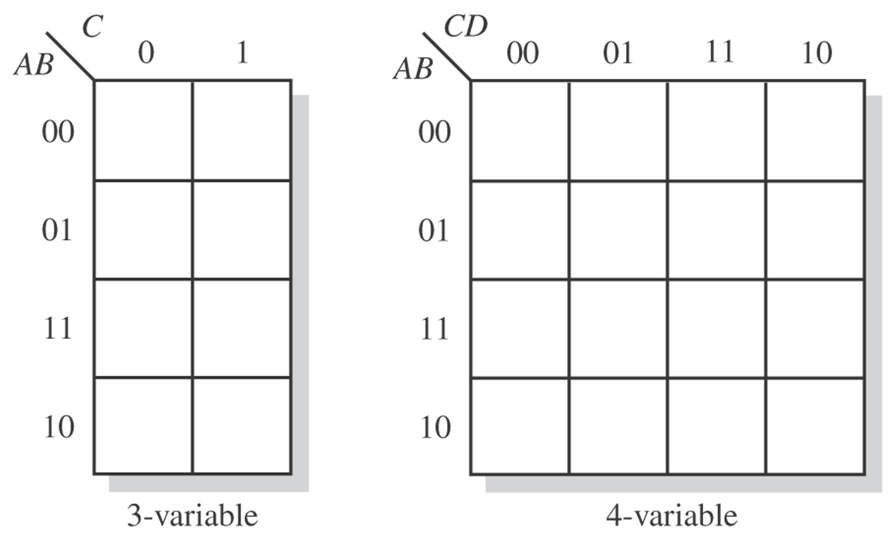
Figure 4–54
Notes:
37

Slide 38
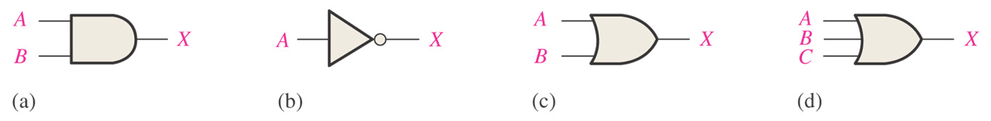
Figure 4–55. What is the Boolean expression for each of the logic gates?
Notes:
38

Slide 39
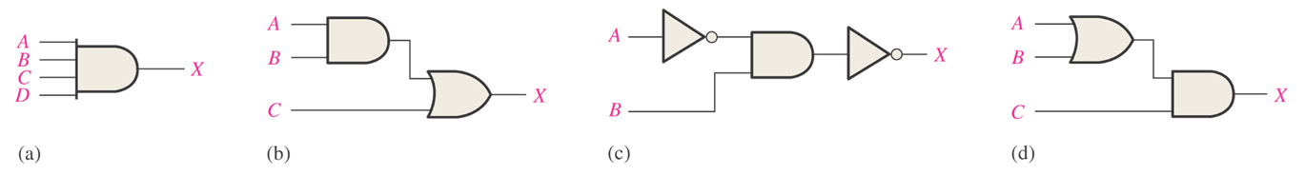
Figure 4–56. What is the Boolean expression for each of the logic gates?
Notes:
39

Slide 40
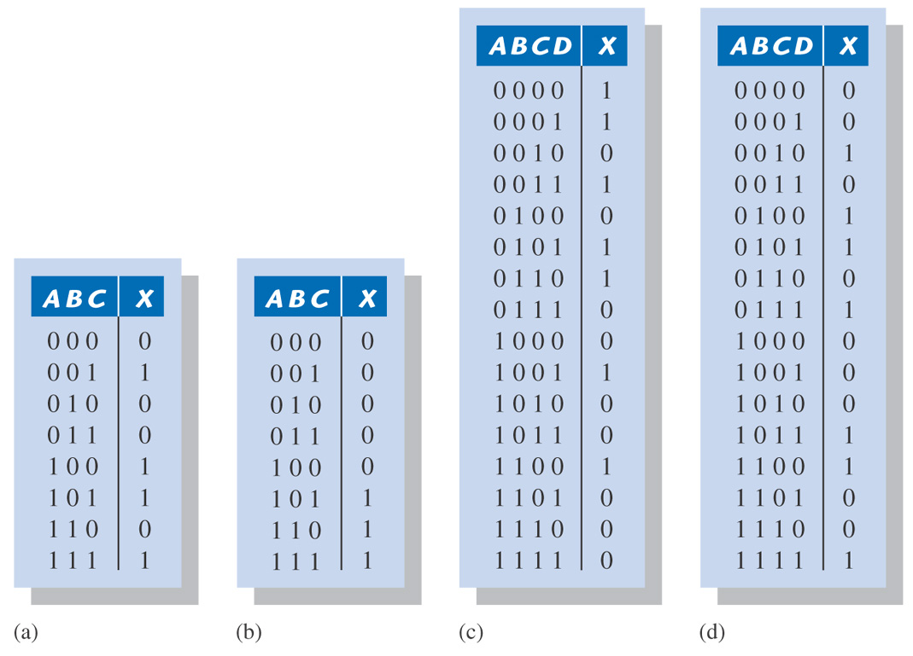
Figure 4–58. Derive a standard SOP and standard POS expression for each truth table.
Notes:
40

Slide 41
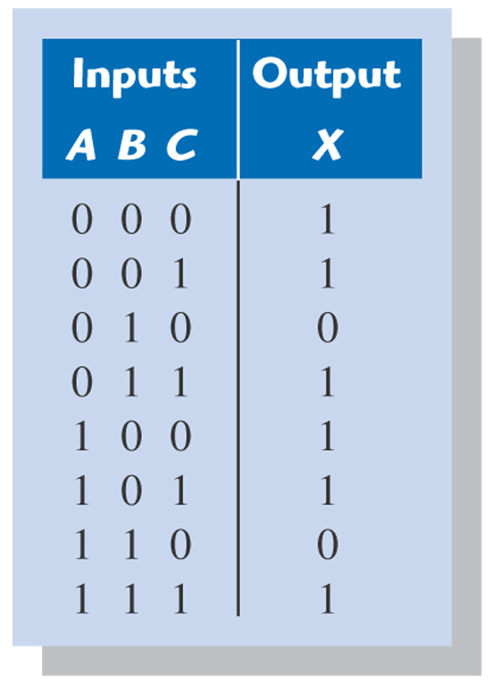
Figure 4–59. Reduce the function in the truth table to its minimum SOP form by using a Karnaugh map.
Notes:
41

Slide 42
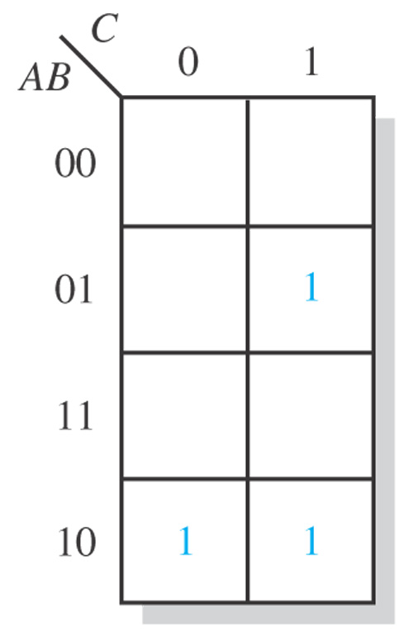
Figure 4–62. Example 4-21. Related Problem answer.
Notes:
42

Slide 43
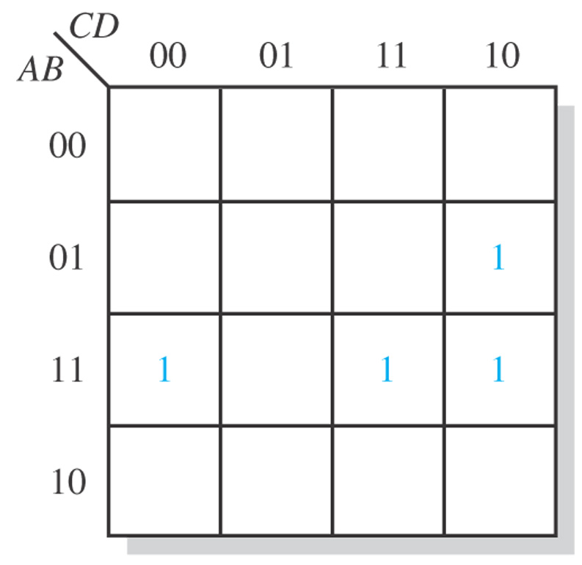
Figure 4–63. Example 4-22. Related Problem answer.
Notes:
43

Slide 44
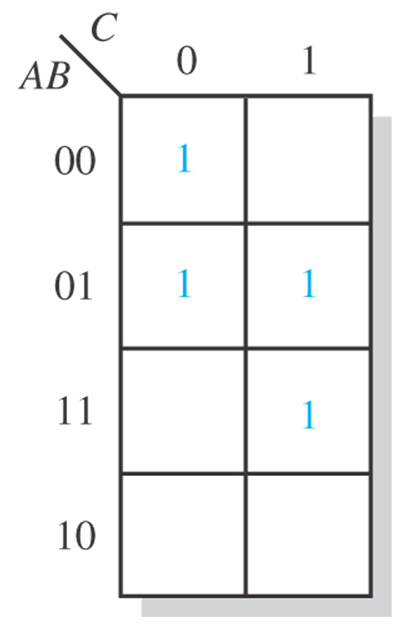
Figure 4–64. Example 4-23. Related Problem answer.
Notes:
44

Slide 45
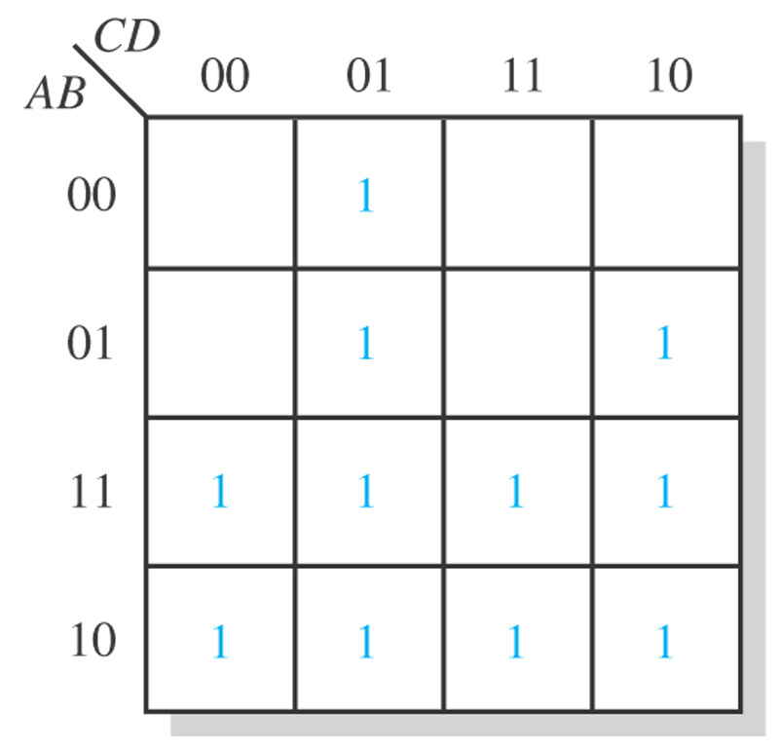
Figure 4–65. Example 4-24. Related Problem answer.
Notes:
45

Slide 46
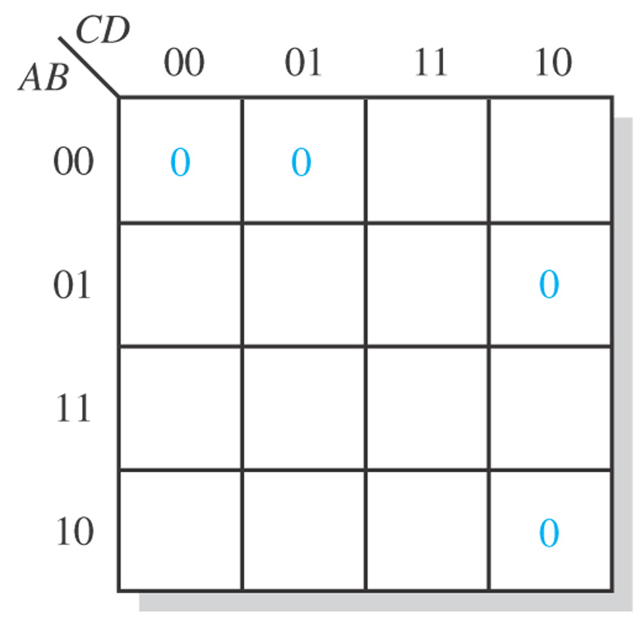
Figure 4–66. Example 4-30. Related Problem answer.
Notes:
46

